Slide 1


Inspired by Bishop Patteson Day
Act of Collective Worship
Notes:
Annual Lesser Festival commemoration of the life and martyrdom of Bishop John Coleridge Patteson – 20th September
If you use the colours of the Church calendar on your worship / reflection table – it will be red for today.
You may wish to use this musical recording from the Melanesian Brothers, as you enter worship – it gives a flavour of life and sung worship:
Glorious Harmony - https://www.youtube.com/watch?v=MYOkCQwr_6E
Lesser festivals mark and celebrate events in the life of Christ, Christ’s presence in the lives of the saints, and prominent festivals of the church. Observing these lesser festivals is a way of recovering and upholding the sense of the communion of saints that is so important to our understanding of the church: "I believe in the Holy Spirit, the holy catholic church, the communion of saints. . ." (Apostles’ Creed, Third Article).
Unless otherwise stated, all images used in this presentation have been taken from https://pixabay.com/ under the creative commons licence.

Slide 2
Gather
Call: The Lord be with you.
Response: And also, with you.

Slide 3
Gather
Dear God,
Thank you that you are here with us.
As we explore the life of Bishop Patteson help us to grow a deeper understanding of what it means to be called by you to love and serve others with all that we are.
Amen

Slide 4

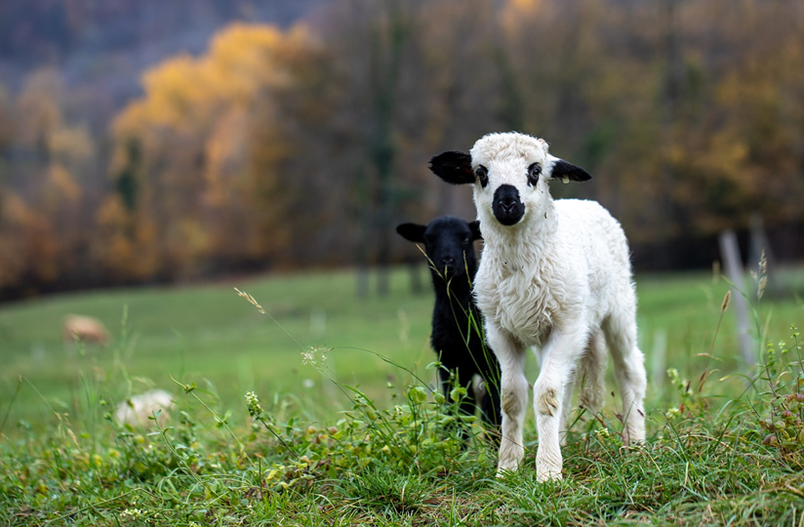
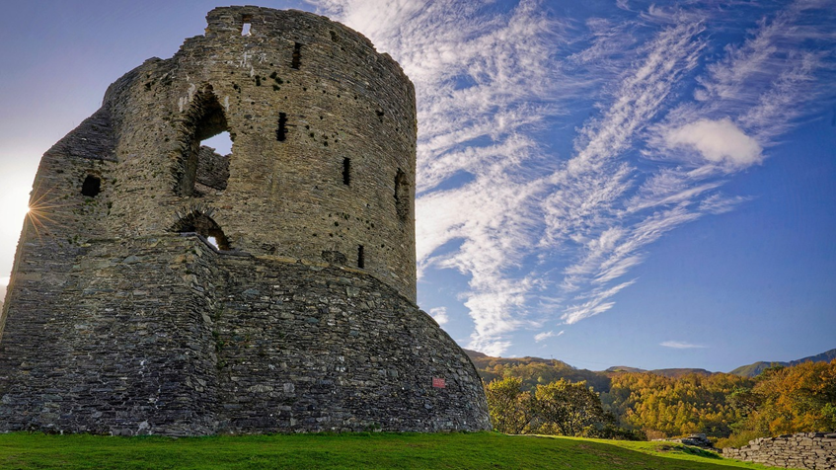

Engage
Where in the world
am I?
Clue 1 Clue 2 Clue 3
Notes:
Clue 1 – Sheep / roast lamb!!
Clue 2 – castles & hills
Clue 3 – Welsh flag

Slide 5
Engage
Where in the world
am I?
Wales

Slide 6

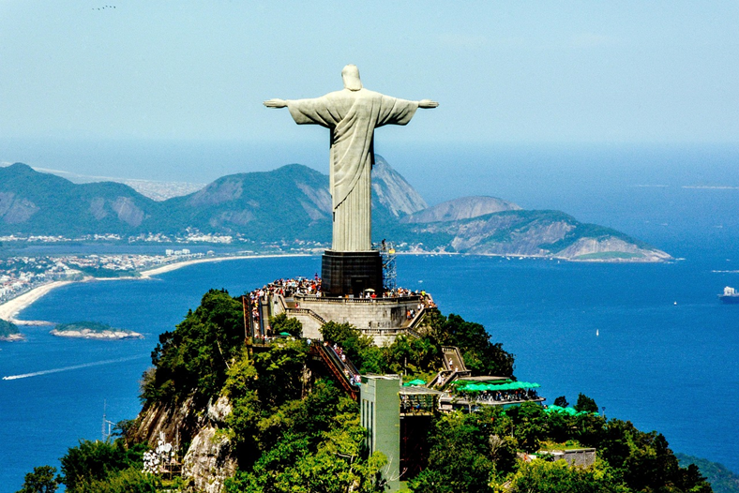

Engage
Where in the world
am I?
Clue 1 Clue 2 Clue 3
Notes:
Clue 1 – National football team
Clue 2 – Christ the Redeemer statue
Clue 3 – Brazilian Flag

Slide 7
Engage
Where in the world
am I?
Brazil

Slide 8

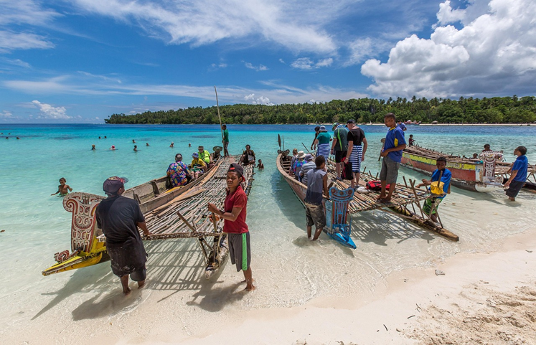

Engage
Where in the world
am I?
Clue 1 Clue 2 Clue 3
Notes:
Clue 1 – Frangipani flowers
Clue 2 – white sand, blue seas & canoe travel
Clue 3 – Solomon Island’s flag – one of the five that make up the region of the South Pacific known as Melanesia

Slide 9
Engage
Where in the world am I?
Melanesia

Slide 10
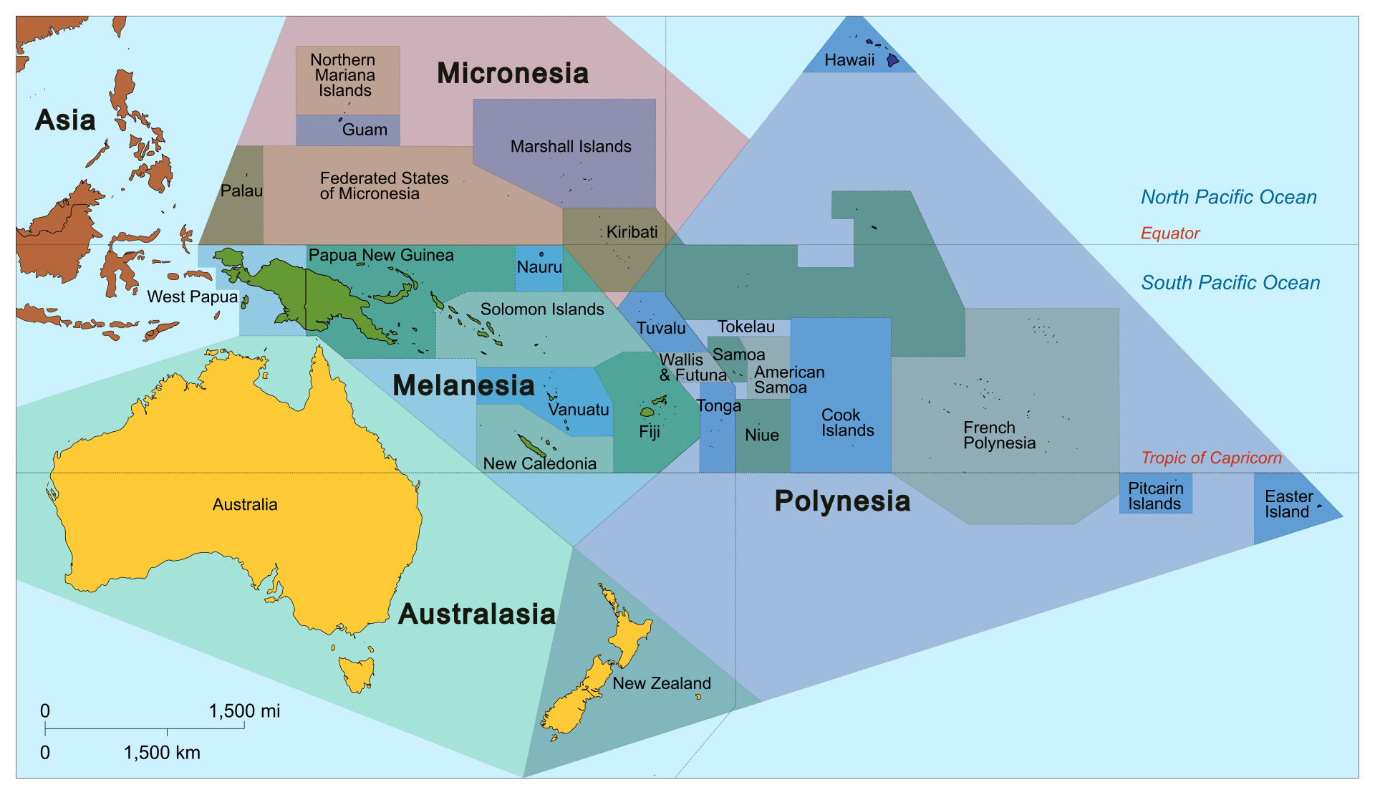
Melanesia Fact File
A group of islands in the South Pacific, Oceania

Slide 11
Melanesia Fact File
Solomon Islands
Papua New Guinea
Fiji
New Caledonia
Vanuatu
Notes:
A collection of 250 islands split into 5 groups.

Slide 12
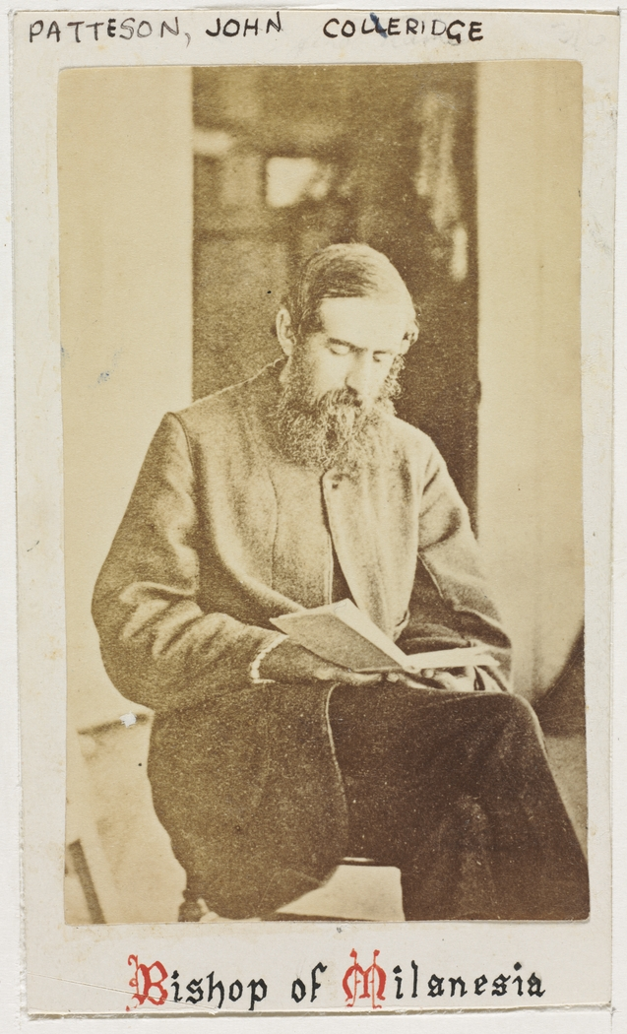
Engage
What is Bishop Patteson Day?
Bishop Patteson day has been commemorated each year on 20th September since 1872.
It is celebrated by Christians in Melanesia and by organisations who partner with them, such as Chester Diocese.
The day commemorates John Coleridge Patteson who was born in 1827. He came via New Zealand, to work with Bishop Selwyn, telling people in Melanesia about Jesus. He was brilliant at learning new languages and used this skill to help people understand more about God’s love for them.
Notes:
Image found from Google search of Bishop Patteson - John_Coleridge_Patteson_D.D.,_Bishop_of_Melanesia,_186-_,_photographer_unknown_(6799635461) – license: free to use & share
Bishop Selwyn was the first English Bishop of New Zealand, he was convinced of the need for the Anglican Church to be part of sharing the Gospel good news to Melanesia. He met Rev John Coleridge Patteson in England in 1854 and decided he should lead in this mission. Aged 28, he travelled the following year to begin. 6 years later, he was consecrated the first Bishop (+) of Melanesia, and head of the Melanesian Mission, aged 34.
Educated at Eton and Oxford, Patteson learnt Latin, Greek, German and Hebrew amongst others. He went on to learn 23 of the local Melanesian languages, including Pidgin and even translated Luke’s Gospel into the Mota language.
He sailed around the islands of Melanesia, preaching the good news about Jesus and setting up schools to educate the indigenous people. He required those that came to help to genuinely be ‘a brother to the Melanesian natives.’ He felt strongly that a racist attitude of superiority be eradicated and play no part in taking the message of Christ to the islanders.
He based himself on Norfolk Island from 1867, his home served as a school, a chapel and a mission station. He campaigned tirelessly against slavery and the practice of blackbirding – the practice of kidnapping people to work as poorly paid labourers - that was prevalent in the area. He wrote letters to Church leaders and the British Government in attempt to stop these practices.

Slide 13
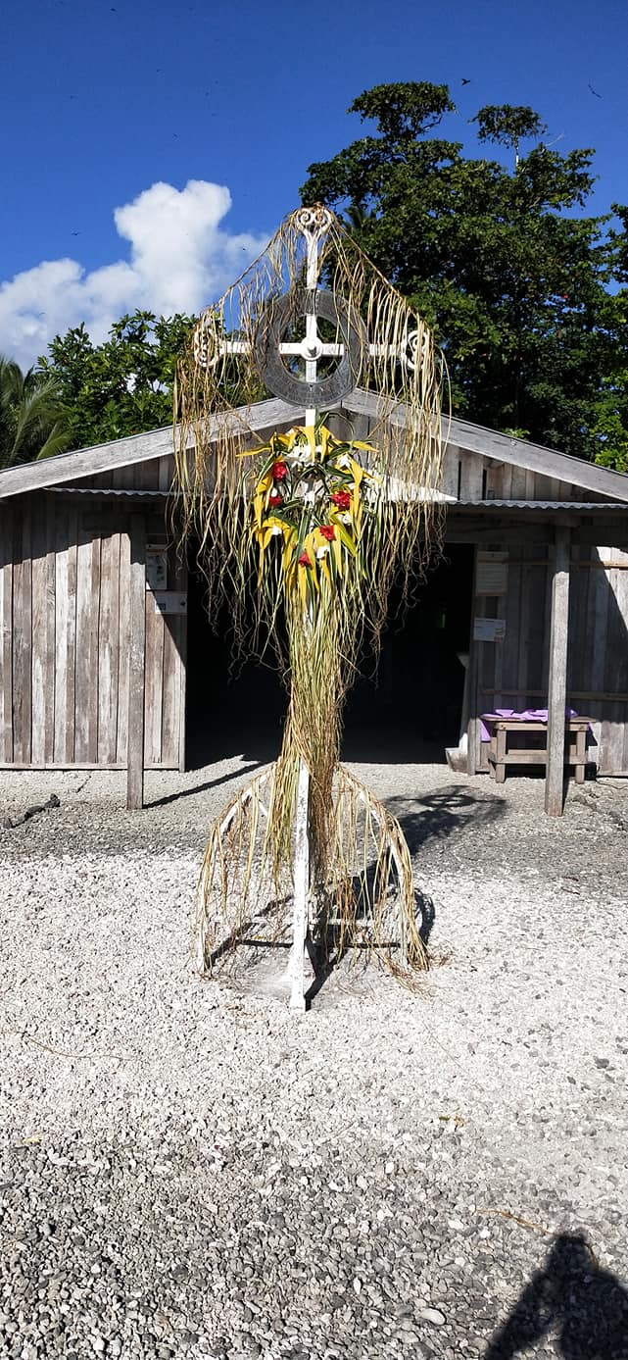
Engage
Bishop Patteson was killed on the reef island of Nukapu on 20 September 1871, by people who, it is believed, wanted revenge on the slave traders who had recently visited the island. This was especially sad as the slave trade was something that Bishop Patteson had tried to stop.
Melanesian Christians celebrate this day by gathering together the night before to sing songs and reenact Bishop Patteson’s life and work. On 20 September, they commemorate his life with a Eucharist service followed by a feast for the community with traditional dancing.
Memorial Cross to Bishop Patterson
on the Island of Nukapu
Notes:
With thanks to Katie Drew, CEO of Melanesia Mission UK (MMUK) for use of this image.
You might like to take some feedback on the reflection questions. You may want to draw out that Bishop Patteson was an advocate who stood up to injustice as part of his Christian faith.
On the 20th September 1871, +Patteson was aboard the missionary ship, the Southern Cross II with his crew and fellow missionaries. As a reef island, he left the crew and took a native canoe to approach closer to the island. He was aged 44. He was welcomed ashore, however, received a fatal blow to the head. It is understood that this was in revenge for 5 young men who had recently been kidnapped by slave traders who came to the island in the weeks earlier. It is said, having realized their mistake, the islanders treated his body with respect, gently wrapped Bishop Patteson’s body in palm leaves and began preparing a grave. As they carried him by canoe toward the burial site, they spotted the Southern Cross mission ship approaching and, fearing retribution, abandoned the canoe with his body inside. The crew of the Southern Cross later recovered Bishop Patteson and, with reverence, buried him at sea. To this day, on the island of Nukapu, you can still see the place where he was to have been laid to rest—and a memorial cross now stands there in his honour. (see attached image).
+Patteson’s death had a significant impact – the British Government resolved to stamp out slavery and the underhand practice of blackbirding in their Pacific territories and regulate seasonal labour practices…something that +Patteson had written to them about in January of 1871.

Slide 14

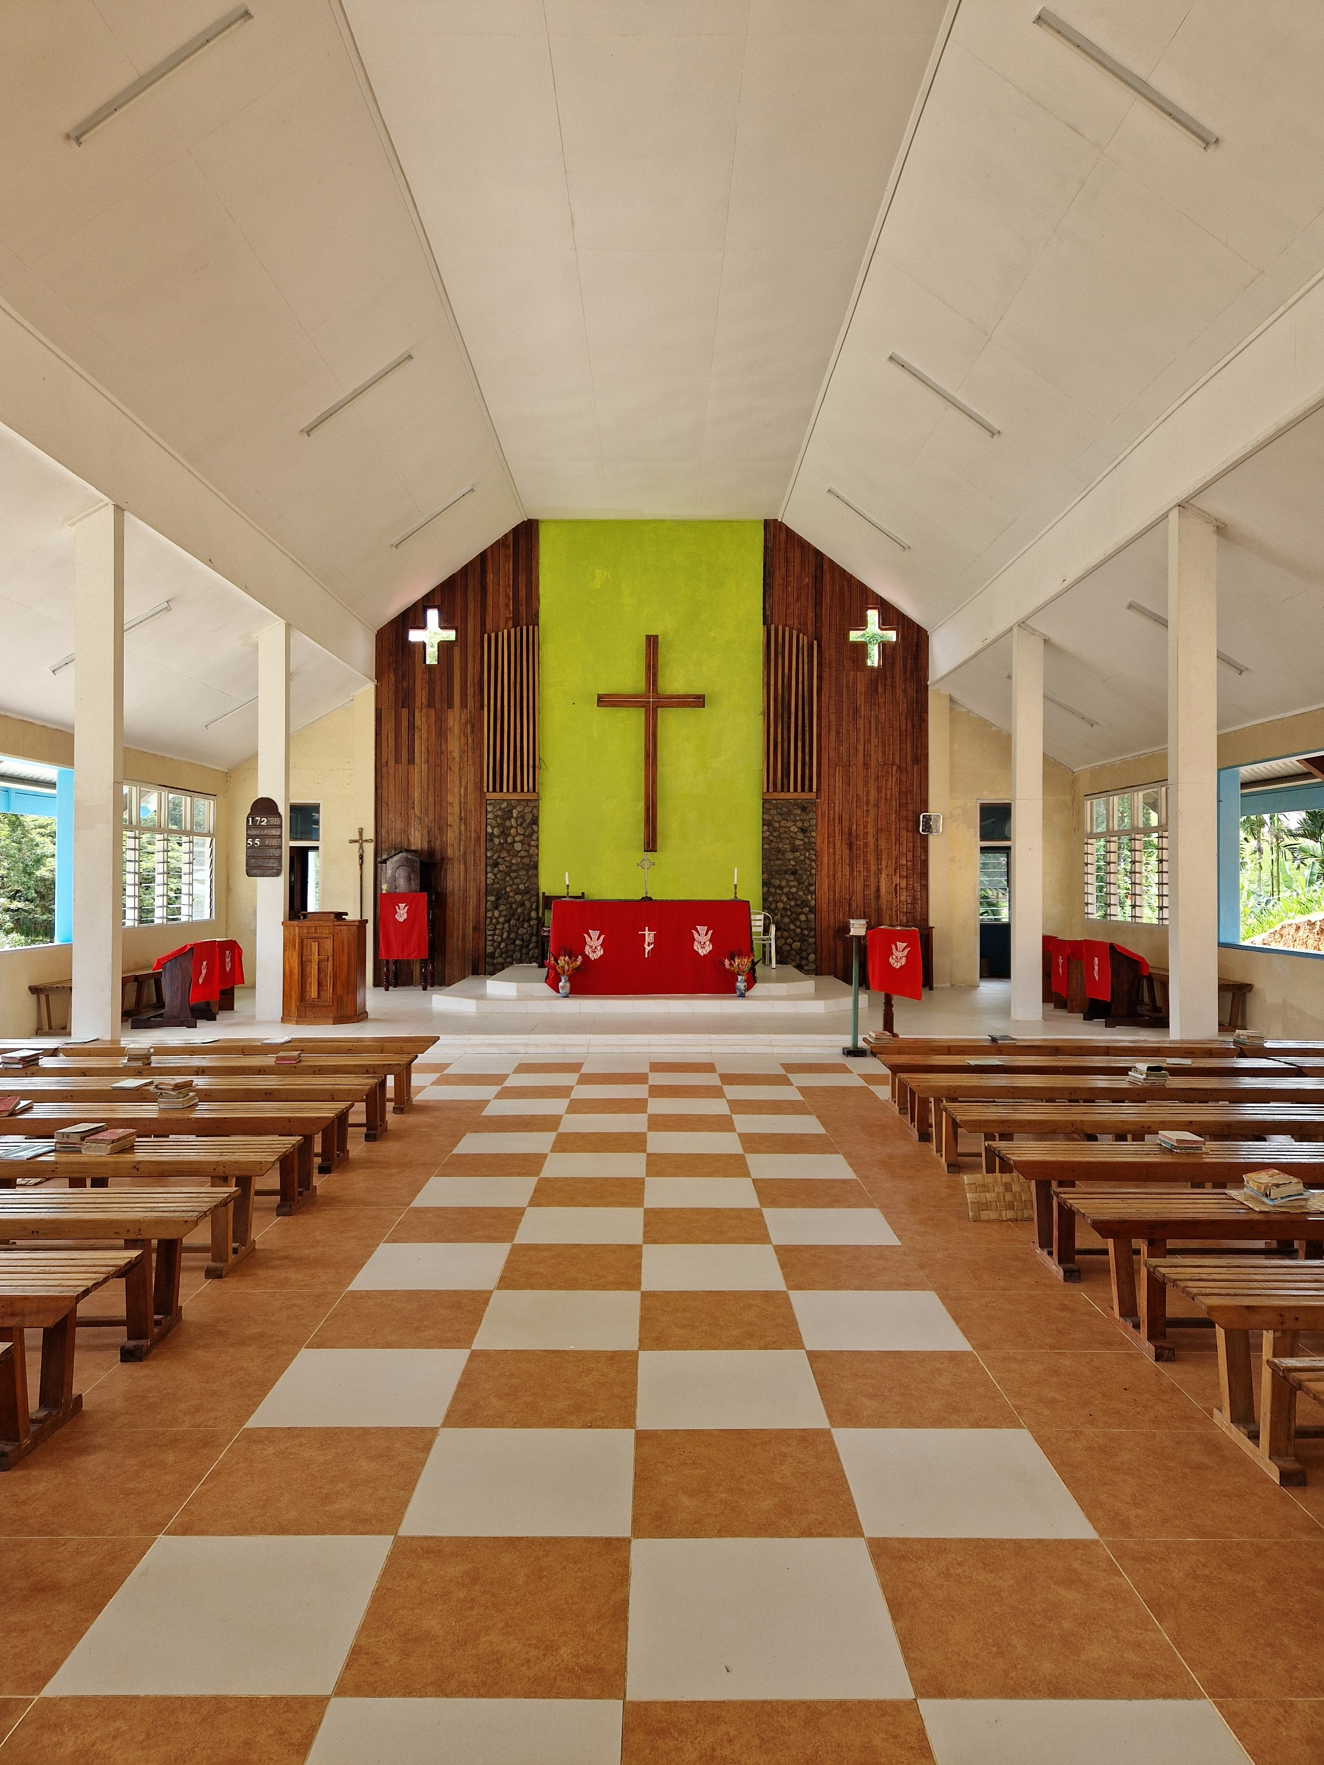
Reflect
Choose a question to think about with a partner…
Why do you think Christians in Melanesia still commemorate Bishop Patteson?
Why do you think Bishop Patteson was willing to tell people about Jesus if it could be so dangerous?
Are there any significant events or people in your life that you like to remember? Why?
Add in image here
Notes:
You might like to take some feedback on the reflection questions. You may want to draw out that Bishop Patteson was an advocate who stood up to injustice as part of his Christian faith.
With thanks to +Sam Corley, Bishop of Stockport for the use of this image.

Slide 15
Reflect
Choose a question to reflect on by yourself…
How might these verses have inspired Bishop Patteson’s actions?
In what ways do you think Bishop Patteson lived out these verses?
Do these verses encourage you in any way? How?
Is there anything you might want to do differently because of these verses or Bishop Patteson’s example?
“
We do not preach about ourselves. But we preach that Jesus Christ is Lord; and we preach that we are your servants for Jesus. God once said, “Let the light shine out of the darkness!” And this is the same God who made his light shine in our hearts. He gave us light by letting us know the glory of God that is in the face of Christ.
2 Corinthians 4:5-6
”
Notes:
You might like to take some feedback on the reflection questions.
Bible passage – 2 Corinthians 4:5-6 ~ taken from the Anglican Communion of Melanesia Lectionary for this day…International Children’s Bible translation.

Slide 16
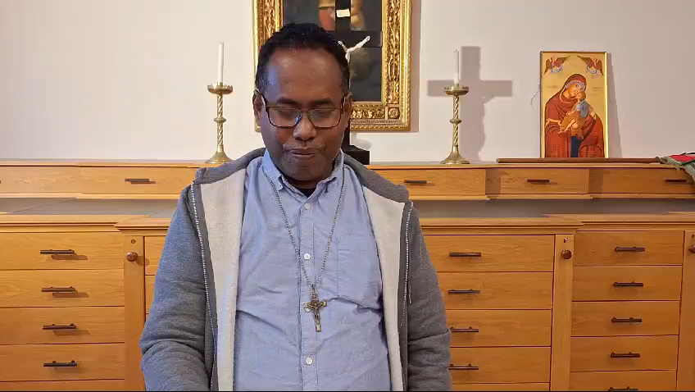
Respond
The Lord’s Prayer spoken in the Melanesian dialect of Pidgin.
Amen
Notes:
Spoken by Fr Nelson, a Melanesian priest (and former Melanesian Brother)
With thanks to Colin Butler, trustee of MMUK, for use of this video.

Slide 17
Send
You may like to continue responding to this worship by choosing one of these options…
Word
Find out more about the life of Bishop Patteson, or how Melanesian Christians celebrate the day.
Action
Is there an action you’d like to take to celebrate Bishop Patteson? Or perhaps to stand up for an injustice?
Emotion
Join with a group of friends to learn The Lord’s Prayer in Pidgin OR create a dance to; ‘Jesus You Hold My Hand’ and share this in celebration worship.
Symbol
Find images that express Christian worship in Melanesia. What do you notice?
How do these images make you feel?

Slide 18

Blessing
"Go in peace,
be brave,
hold fast to that which is good,
give no one evil for evil,
strengthen those who are afraid,
hold up the weak,
help those in trouble,
honour all people,
love and serve the Lord,
be full of joy in the power of the Spirit“
(from the Melanesian Prayer Book)

Slide 19

Send
Jisas yu holem han blong mi
Jesus Hold My Hand
[Verse One]
Jisas yu holem han blong mi
Jesus Hold My Hand
Yu tekem han blong mi
Take My Hand
Aba mi kraeaot fo yu
Abba, I Cry Out For You
Yu nao faen evri gud samting
You Find Every Good Thing
Long disfala wol
In This World
Aba mi kraeaot fo yu
Abba, I Cry Out For You
[Verse Two]
Baba mi daon tenk yu long yu
Abba, I Humbly Thank You
Fo Sendem San blo yu
For Sending Your Son
Fo dae fo sins blong mi
Who Died For My Sins
Waswe I re-redi fo hem
So I Will Be Ready For Him
Baba hem I kam Mek yu dae fo
Abba, He Will Come Again
[Chorus]
Jisas mi kam long yu nao, uuuh
Jesus, I Come To You Now Ohhh
Yu tekem mi distaem, uuuh
Take Me Now Ohhh
San Jisas mi kam long yu nao, uuuh
Son Jesu, I Come To You Now
Yu tekem mi distaem
Take Me Now
Notes:
You may wish to listen to this Melanesian song of worship, sung in pidgin, as the pupils leave the worship.
This song was written in 1990 by Benjamin Tekulu, at King George VI in Honoria. It was used by Sony Pictures in 1998 in the film, ‘The Thin Red Line’
https://www.youtube.com/watch?v=AppM4u1gnG0

